Slide 1
React JS Training
Prateek
(Reacttrainer17@gmail.com)

Slide 2

Agenda
Introduction to ES6 Classes
scopes: let and const Arrow functions Destructuring Spread Operator Promise Concept
Introduction to React.js Why use?
Comparison with other frameworks
Components
Virtual DOM JSX
Hands-on exercises

Slide 3


ES6 Classes
Classes are a template for creating objects. They encapsulate data with code to work on that data.
Classes are in fact "special functions", and just as you can define function expressions and function declarations, the class syntax has two components: class expressions and class declarations.

Slide 4
var, let and const
Var :
Global scoped or function scoped.
Can be redeclared
Let :
The scope of a let variable is only block scoped
Can’t be redeclared but the value can be changed
Const :
The scope of a const variable is only block scoped
Can’t be redeclared and can’t be changed

Slide 5
Arrow functions
Arrow functions allow us to write shorter function syntax.
Example :
let myFunction = a => a * a;
Arrow function doesn't define its own execution context
Arrow functions don't have their own bindings to this, arguments or super

Slide 6
Destructuring and Spread Operator
Destructuring is used to take out sections of data from an array or objects, We can assign them to new own variables
It does not change an array or any object, it makes a copy of the desired object or array element by assigning them in its own new variables
Spread Operator (…) allows an iterable, such as an array or string, to be expanded in places where zero or more properties or elements are expected

Slide 7
React Js

Slide 8
Why React.?
Complexity of two-way data binding
Bad UX from using "cascading updates" of DOM tree
A lot of data on a page changing over time
Shift from MVC mentality
Lighter and Easier to load
Virtual DOM to increase performance
Supported by META(earlier Facebook)

Slide 9
React JS
React is a free and open-source front-end JavaScript library for building user interfaces based on UI components. It is maintained by Meta and a community of individual developers and companies.
React is a JavaScript library for building user interfaces. React is used to build single-page applications. React allows us to create reusable UI

Slide 10
JSX and Virtual DOM
The virtual DOM (VDOM) is a programming concept where an ideal, or “virtual”, representation of a UI is kept in memory and synced with the “real” DOM by a library such as ReactDOM
JSX stands for JavaScript XML. JSX allows us to write HTML in React. JSX makes it easier to write and add HTML in React

Slide 11
React App Creation and Hands On End of Day 1

Slide 12
Agenda
The Core of React
Class DOM
React Components - stateful & stateless Elements
Lifecycle State Props
Invoking web services
Component inter communication:
Parent and child component Communication Uses of function delegation
Handling events
Chrome plugin for React Webpack, Babel
Hands-on exercises

Slide 13
DOM (Document Object Model)
The HTML DOM model is constructed as a tree of Objects.
With this object mode JavaScript can:
change all the HTML elements in the page
change all the HTML attributes in the page
change all the CSS styles in the page
add/remove existing HTML elements and attributes
react to all existing HTML events in the page

Slide 14
Component
Components are independent and reusable bits of code. They serve the same purpose as JavaScript functions, but work in isolation and return HTML.
Components come in two types, Class components and Function components

Slide 15
Class Component
The component's name MUST start with an upper case letter
A class component must include the extends React.Component statement.
The component also requires a render() method, this method returns HTML

Slide 16
State and Props
State is an instance of React Component Class can be defined as an object of a set of observable properties that control the behavior of the component.
State of a component is an object that holds some information that may change over the lifetime of the component
Props are arguments passed into React components
Props are immutable unlike state

Slide 17
Component Lifecycle
componentWillUnmount()
Mounting
constructor()
render()
componentDidMount()
Updating
shouldComponentUpdate()
render()
getSnapshotBeforeUpdate()
componentDidUpdate()
UnMounting
componentWillUnmount()

Slide 18
HOC
A higher-order component (HOC) is an advanced technique in React for reusing component logic.
A higher-order component transforms a component into another component.
HOCs are common in third-party React libraries, example - Redux’s connect.

Slide 19
Function Component
A Function component also returns HTML, and behaves much the same way as a Class component
There is no render method used in functional components.
Functional components are basic JavaScript functions. They can be created using arrow functions and can also be created with the regular function keyword

Slide 20
React Hooks
Hooks are a new addition in React 16.8. They let you use state and other React features without writing a class.
useState is a Hook that lets you add React state to function components.
useEffect is a hook that lets you add componentdidmount and componentDidUpdate in a function component

Slide 21
Routing
Routing allows your web application to support multiple paths(routes)
React-router-dom is the library which is used in react for enabling routing
It enables the navigation among views of various components in a React Application

Slide 22
Redux
Redux is an open-source JavaScript library used to manage application state.
It allows React components to read data from a Redux Store, and dispatch Actions to the Store to update data
It subscribes to the Redux store, checks to see if the data which your component wants have changed, and re-renders your component.

Slide 23
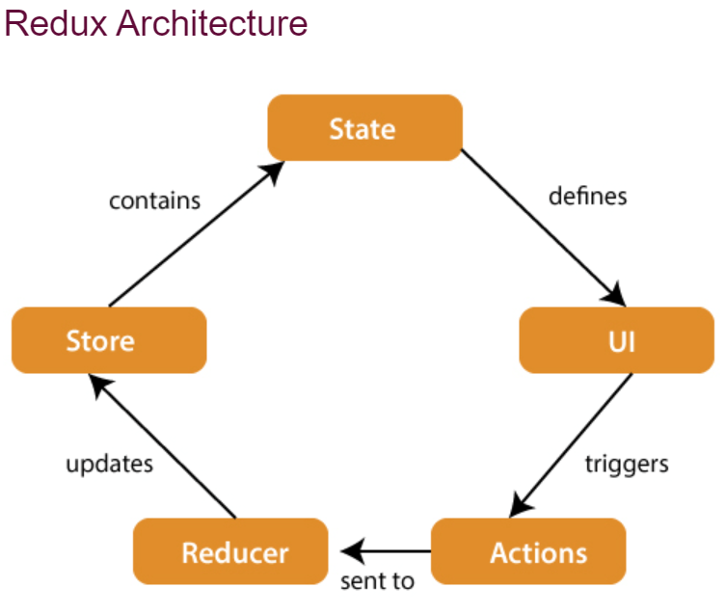

Slide 24
Redux Components
There are 3 components of redux:
Store
Action
Reducer
STORE: A Store is a place where the entire state of your application lists. It manages the status of the application and has a dispatch(action) function. It is like a brain responsible for all moving parts in Redux.

Slide 25
Redux Components
ACTION: Action is sent or dispatched from the view which are payloads that can be read by Reducers. It includes information such as type of action, time of occurrence, location of occurrence, its coordinates, and which state it aims to change.
REDUCER: Reducer read the payloads from the actions and then updates the store via the state accordingly. It is a pure function to return a new state from the initial state.

Slide 26
REST APIs + React
REST is an acronym for REpresentational State Transfer
A Web API (or Web Service) conforming to the REST architectural style is a REST API.
REST defines 6 architectural constraints which make any web service RESTful -Uniform interface ,Client–server, Stateless , Cacheable ,Layered system ,Code on demand (optional)

Slide 27
HTTP Verbs
GET: Used to request data from an endpoint
DELETE: Remove data from an endpoint.
POST: is always for creating a resource ( does not matter if it was duplicated )
PUT: is for checking if resource exists then update, else create new resource
PATCH: is always for updating a resource

Slide 28
REST APIs from component
STEPS:
User visits webpage
The component is mounted to the DOM (webpage)
The componentDidMount or useEffect method is called sending off the HTTP request
The webpage gives an indication it is loading data
The data is received from the external API and added to state (side effect)
The component renders with the data that was fetched.

Slide 29
UNIT Testing(JEST)
Unit Testing is a testing method that tests an individual unit of software in isolation. Unit testing for React Apps means testing an individual React Component.
Jest is a JavaScript testing framework that allows developers to run tests on JavaScript and TypeScript code and can be easily integrated with React JS.

Slide 30
Structure of a test case
A test is usually written in a test block.
Inside the test block, the first thing we do is to render the component that we want to test.
Select the elements that we want to interact with
Interact with those elements
Assert that the results are as expected.

Slide 31




Thank you
Prateek
(Reacttrainer17@gmail.com)

